Slide 1
State of Michigan Departmental Reorganization and
Navigation of michigancc.net
Gail Ives Kelly Simmons
KS-1

Slide 2
State of Michigan Departments Interacting Directly with Community Colleges
Dept of Education (MDE)
Talent & Economic Development (TED)
Licensing & Regulation (LARA)
Dept of Technology, Management & Budget (DTMB)
Dept of
Treasury
Dept of Military & Veteran Affairs
Dual Enrollment
Talent Investment Agency (TIA)
Occupation Licenses
Budget Office
Tuition Scholarships
Tuition Scholarships
Early & Middle Colleges
Center for Educ. Perf. and Info. (CEPI)
Unemployment Insurance Agency (UIA)
Workforce Development Agency (WDA)
Perkins Secondary CTE
Comm. Coll. Svcs. Unit (CCSU)
MI Dashboards
Labor Market Information (LMI)
KS-2

Slide 3
State of Michigan Talent & Economic Development (TED) Org Chart
Steve Arwood
Executive Director
Talent & Economic Development (TED)
Wanda Stokes
Director
Talent Investment Agency (TIA)
Stephanie Beckhorn
Director
Workforce Development Agency (WDA)
Sean Lively
State Division Administrator (WDA)
Education and Career Success (ECS)
Dr. Cliff Akujobi
Manager (WDA/ECS)
Community Colleges Services Unit (CCSU)
Tracy Kuchuk
Secretary (WDA/ECS/CCSU)
Kelly Simmons
Higher Education Consultant (WDA/ECS/CCSU)
Sheree Price
Higher Education Consultant (WDA/ECS/CCSU)
Dr. Tracey Taylor
Higher Education Consultant (WDA/ECS/CCSU)
Judy Becker
Departmental Analyst (WDA/ECS/CCSU)
Darlene Miller
Departmental Analyst (WDA/ECS/CCSU)
KS-3

Slide 4
Navigation of Michigancc.net
Kelly Simmons Higher Education Consultant Community Colleges Services Unit State of Michigan
KS-4

Slide 5
Overview of Data Collections
Nick Baker Eileen Brennan Rachel Edmonson Erin Shirey Deirdre Syms

Slide 6
IPEDS and Perkins
Eileen Brennan Business Intelligence Systems Analyst Institutional Research Henry Ford Community College
EB-1

Slide 7
IPEDS – HISTORY
The U.S. Department of Education was established in 1967.
Data collection began in 1869-1870, and included enrollment, degrees conferred, and faculty.
NCES – the National Center for Education Statistics, was established in 1974.
IPEDS – the Integrated Postsecondary Education Data System, was inaugurated in 1985.
IPEDS became a web-based data collection in 2000-2001.
EB-2

Slide 8
IPEDS - MANDATES
IPEDS Data Submission is mandatory for any Title IV participating postsecondary institution. The Department of Education Office of Federal Student Aid can issue fines to or revoke Title IV eligibility for institutions not complying with requirements.
Some information collected is used to meet Carl D. Perkins Vocational Education Act requirements.
Many data collection items are used for federal “Student Right to Know” requirements.
Many data collection items are used for federal “Consumer Information” requirements.
EB-3

Slide 9
IPEDS - PURPOSE
All Postsecondary Educational Institutions submit like data on common measures – e.g., enrollment, staffing, finance.
Data submission helps institutions meet accountability requirements of federal higher education legislation and funding.
IPEDS data allow for comparisons among institutions on common measures.
Focus: Enrollment and Outcomes counts by student; Overall institutional information including staffing, revenues, and expenditures.
Note, key measures such as graduation rate and net price of attendance (a financial aid measure) are based on first-time in any college (FTIAC), full-time, degree-seeking students.
EB-4

Slide 10
IPEDS - ELEMENTS
INSTITUTIONAL CHARACTERISTICS – Information about an institution including tuition and fees, services offered, admission requirements.
ENROLLMENT – Full Year and Fall, by Gender, Race and Ethnicity
STUDENT OUTCOMES –
Completions – All awards conferred by Gender, Race and Ethnicity
Graduation Rates – Percentage of Full-time, First Time in Any College students who complete within a given range
Transfer Out Rates - Percentage of Full-time, First Time in Any College students who transfer out within a given range
Outcome Measures – Transfer and Graduation rates after six and eight years for full and part time students.
STUDENT FINANCIAL AID –
Number and percentage of students receiving any aid, federal aid, loans, state aid, and institutional aid, and aggregate amount of these types of aid
HUMAN RESOURCES – Faculty/Staff by Gender, Race and Ethnicity categorized into functional areas, Salaries and Benefits by functional areas.
FINANCE – Revenues and expenditures by functional areas such as instruction, support, and administration.
EB-5

Slide 11
IPEDS – Where Data Appear
College Navigator, a site designed to provide information to the general public. http://nces.ed.gov/collegenavigator/
IPEDS Data Center. Interested users can access standardized reports or full data sets for all measures collected or calculated in IPEDS for any participating institution. http://nces.ed.gov/ipeds/datacenter/
College Affordability and Transparency Center. Includes links to the Department of Education’s College Scorecard, lists of institutions by sector with highest and lowest costs of attendance, lists of institutions by sector with highest increases in cost of attendance, and state spending charts. http://collegecost.ed.gov/
EB-6

Slide 12
IPEDS – Resources
“The History and Origins of Survey Items for the Integrated Postsecondary Education Data System,” Report of the National Postsecondary Education Cooperative. Fuller, C. (2011). The History and Origins of Survey Items for the Integrated Postsecondary Education Data System, (NPEC 2012-833). U.S. Department of Education. Washington, DC: National Postsecondary Education Cooperative. Retrieved [date] from http://nces.ed.gov/pubs2012/2012833.pdf
Instructions and sample reporting screens for the current year can be accessed on the IPEDS web page, “Report Your Data.” The following is a link to access collection materials for 2015-16. Watch for updates to 2016-17. http://nces.ed.gov/ipeds/Home/ReportYourData
“IPEDS New Keyholders Handbook.” A comprehensive guide to IPEDS data collection and usage, not just for new keyholders. The following link is for the 2015-16 edition. It may or may not be updated for 2016-17. If not available, look under the Reporting Guides section on the Report Your Data page. https://surveys.nces.ed.gov/ipeds/downloads/201516%20New%20KH%20Handbook%20all%20final.pdf
IPEDS Data Center and related resources: http://nces.ed.gov/ipeds/Home/UseTheData
NCES Distance Learning Dataset Training. Web-based introduction to all NCES datasets, including IPEDS. http://nces.ed.gov/training/datauser/
EB-7

Slide 13
Perkins Core Indicators - History
“The Carl D. Perkins Vocational and Technical Education Act (Perkins Act) was first authorized in 1984 and again in 1998. Its purpose is to increase the quality of technical education in the United States. In 2006, the Act was reauthorized as the Carl D. Perkins Career and Technical Education Improvement Act of 2006.” (Source: www.aypf.org/documents/PerkinsActFactSheet.pdf).
Perkins funding also addresses special populations, those who may need assistance in accessing and benefiting from career/technical education including students who are economically disadvantaged, ESL students, single parents, displaced homemakers, and those who are in programs non-traditional for their gender. It once included students who are academically disadvantaged.
The state grant is administered by the Michigan Department of Education; funding covers secondary as well as postsecondary programs and initiatives. The Perkins grant allocations to community colleges are only a part of the overall grant.
Career/technical education programs are identified by CIP code.
Core Indicators are measures of accountability for the grant program, reported by each institution and collected at the state level to determine how we meet expected performance levels.
EB-8

Slide 14
Perkins Core Indicators – Focus, History of Measures
Focus of measures has always been on program enrollment, outcomes, and progressions.
Initial measures were highly linked to IPEDS measures – enrollment, and completions in particular.
This is one of the few longer term data collections in which non-credit/non-degree-seeking students have been consistently tracked, in the Non-Program report.
Measures evolved in the mid 2000’s to address progression in career/technical education, such as completion of academic compared to career technical courses by students in all programs.
Measures have always included disaggregation (or grouping) by program, race/ethnicity, and special populations.
Special populations have always included students for whom English is a second language, economically disadvantaged students, single parent students, and students in programs non-traditional for their gender. Over time, the category of homemaker has split out into homemaker/displaced homemaker. Categories no longer included are academically disadvantaged students and tech prep students (students who participated in Career/Technical programs in secondary articulated into postsecondary credits).
EB-9

Slide 15
Perkins Core Indicators – Current Measures
Accountability measures include IPEDS related measures (Year End Program Enrollment, Non-Program Enrollment), Core Indicators, and financial measures.
More General Measures: Year-End Program Enrollment, Non-Program Enrollment, Fall Enrollment (aligned with IPEDS Fall Enrollment), Awards Conferred (aligned with IPEDS Completions).
Financial Measures: Occupational Expenditures
Institutional Information: Program Inventory, Tuition & Fees
Core Indicators – Measures specifically related to Career Technical Programs
1P1, Technical Skill Attainment
2P1, Completion of an External Credential, Certificate or Degree
3P1, Retention or Transfer
4P1, Student Placement (leavers who continue in higher education, become employed)
Nontraditional Enrollment and Completion
Key definitions for Core Indicators
Concentrator
Participant
EB-10

Slide 16
Perkins Core Indicators – Resources
Dean’s Guide – Section 2.6. This includes instructions for collecting and reporting data, and updated as of 2011. http://www.michigancc.net/Perkins/resources-guide.aspx?PageFunction=ViewGuide.
The most updated instructions and definitions are only accessible with an institution issued logon under the Community Colleges data collection page.
The Resources Tab on the Michigan Community Colleges Network website includes a variety of material including tables of high wage/high demand/high skill programs and non-traditional programs. http://www.michigancc.net/resource/default.aspx.
EB-11

Slide 17
Activity Classification Structure (ACS)
Nick Baker Director, Institutional Research Kirtland Community College
NB-1

Slide 18
ACS – at present
Originally started and published in 1981
Revisions in 2003, 2010 by the Department of Energy, Labor and Economic Growth
Four reports – 3, 5, 6 and 7. Follows the Manual for Uniform Financial Reporting (MUFR).
All of the reports collect information based ACS category: 1.1 General Education, 1.2 Business & Human Services, 1.3 Technical & Industrial Occupations, 1.4 Health Occupations, 1.5 Developmental Ed & Basic Skills, 1.6 Human Development and 1.7 Personal Interest
NB-2

Slide 19
ACS – at present continued
ACS 3 collects information on expenditures
ACS 5 collects information on tuition, taxable value and millage (revenue)
ACS 6 collects information on enrollment including courses, sections; headcount, credit hours, contact hours, occupational contact hours by in-district and out-of-district (used in Perkins Allocation formula)
ACS 7 collects information on physical plant expenditures and activity including square and cubic feet of buildings, energy and water/sewage costs
NB-3

Slide 20
ACS Databook and Manual – available at www.michigancc.net
NB-4

Slide 21
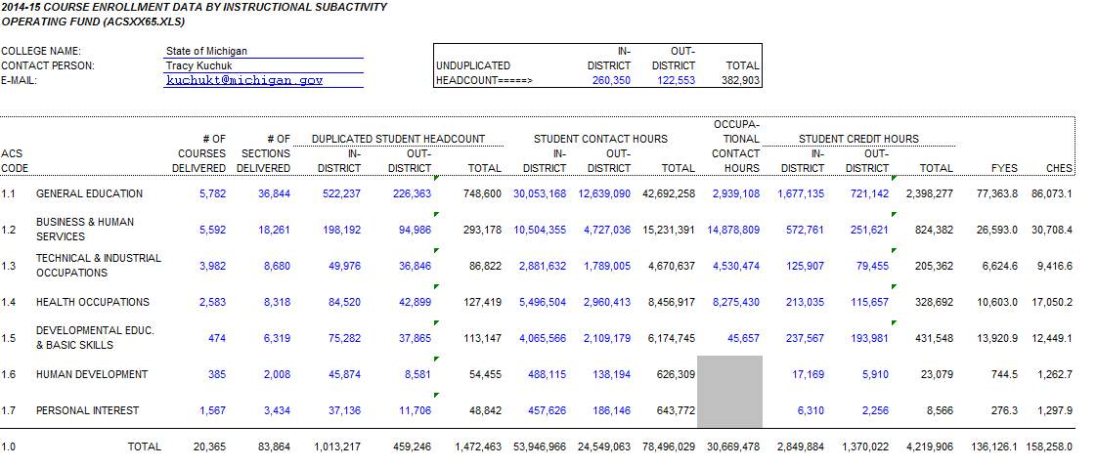
NB-5

Slide 22
Activity Classification Structure Update
Due November 1st annually.
Reporting will be done this year in existing system.
In the future ACS will be reported to CEPI. CEPI is currently assessing what it would take to build a new ACS reporting system.
ACS is transitioning from WDA to CEPI – new reporting website being designed and developed.
Changes to be implemented this year:
FYES calculation to be defined as 30 credit hours instead of 31.
Operating revenues to include both General Fund and Designated Funds.
Tuition and fees should be the gross amount collected by each college.
NB-6

Slide 23
ACS Additions and Changes Proposed
Addition of MPSERS Stabilization Tables to ACS.
Any information required by the Performance Indicator formula for funding will be added to ACS for reporting (Awards/Graduates).
Tuition and Fees reporting in ACS.
Include Capital Outlay Use and additional Finance reporting in ACS.
Employee/personnel reporting – full-time/part-time including FTE and salary information to ACS.
NB-7

Slide 24
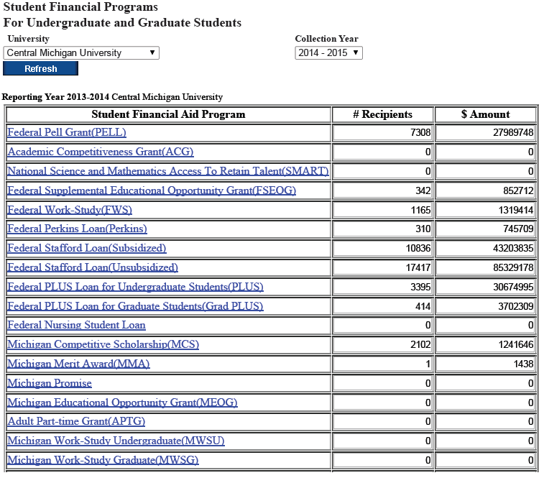
Student Financial Aid
information reported
in ACS – like section 710
reporting required of
Universities.
Automation of collection,
analysis and reports from
the new system – generates
The College Demographic
Profile Report and others
that comes from ACS now.
NB-8

Slide 25
STARR and NSC Reports Using STARR and NSC Data
Rachel Edmonson Adult Learner Student Data Analyst
Michigan Department of Technology, Management and Budget
Center for Educational Performance and Information
RE-1

Slide 26
STARR and NSC - Agenda
STARR
What is STARR?
STARR resources
STARR collection timeline and years available
STARR data available
STARR data quality/tips
NSC
What is the NSC and why do we use it?
NSC collection timeline and years available
NSC data available
NSC data quality/tips
Reports using STARR and NSC data
RE-2

Slide 27
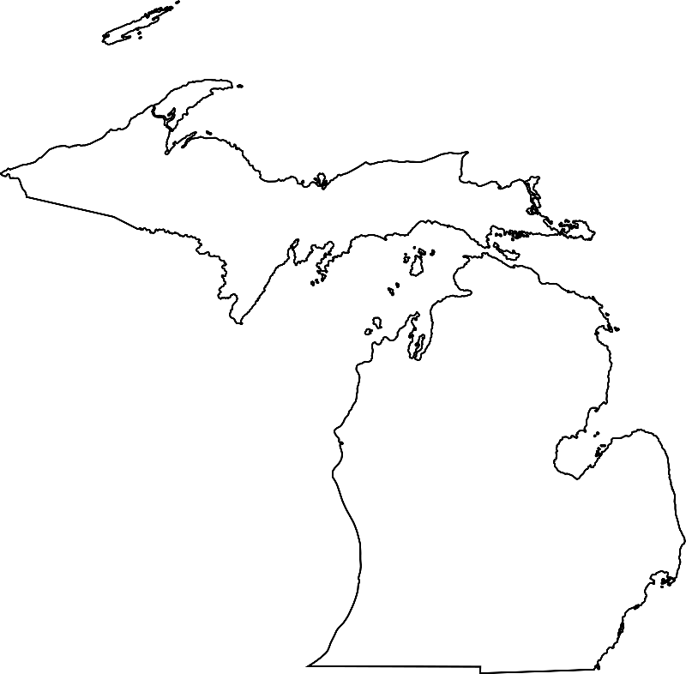
Student Transcript and Academic Record Repository (STARR)
CEPI manages STARR, which currently collects data once a year from 46 Michigan colleges and universities:
43 publics
3 independents
STARR launched in Summer 2011 to fulfill ARRA grant requirements
Utilizes Michigan's Unique Identification Code (UIC) to uniquely identify students
Enables CEPI to connect to other state databases like K-12's Michigan Student Data System (MSDS)
Partners with E-Transcript to ensure that the UIC is on the high school transcript during sending and receiving
Transcript data come to CEPI in XML format via STARR
RE-4
23

Slide 28
STARR Collection Timeline
Postsecondary transcript data is:
Collected in fall (July to October) of each year.
Change this year used to be in the spring (May/June).
New data available for use in the winter of each year.
We have postsecondary transcript data for enrolled students beginning in spring 2009 (2008-09 or 2009-10 school year depending on the college’s academic calendar).
The transcript is submitted to CEPI, which means we have the cumulative record for students. Some of these records go back to the 1950s.
CEPI began collecting data in 2011. The 2011 collection required colleges to submit 2 year’s worth of data (2009-10 and 2010-11 school years). The 2012 and subsequent collections only collect the current school year’s data.
RE-5

Slide 29
STARR Data Available
Unique Identification Code (UIC)
Enrollment date
Academic calendar, year and term
Course Taken (e.g., MTH 100 Intro to Mathematics)
Grade earned
Credit hours attempted and earned
GPA (term and cumulative)
Award date, description, level
Program name
CIP codes on degree, program and course (classification of instructional programs)
Level (e.g., freshman, masters)
Race
Sex (gender)
Age
Pell eligibility
Enrollment date
Dual enrollment and Early Middle College participation
Occurrence may vary for some!
RE-6

Slide 30
What Is the NSC?
NSC is a national data collection that CEPI uses to acquire postsecondary enrollment for students no longer in MI and understand enrollment in private in-state institutions.
NSC stands for “National Student Clearinghouse”.
Not all colleges in the nation submit data to NSC, but a good number do.
NSC data fills in the gaps where STARR leaves off, but STARR is a richer data collection.
CEPI submits the Unique Identification Code (UIC) for two sets of students
High school – based on 9th grade cohorts (graduates and dropouts)
College – all enrollees reported by IHEs
RE-7

Slide 31
NSC Data Available
RIC / UIC
Institution name
2 yr/4 yr institution
Public/private institution
State
Enrollment begin date
Enrollment end date
Enrollment status (full-time/part-time)
Class level (e.g., freshman)
Program name
Program CIP
Graduated (Y/N)
Graduation date
Degree title
Degree CIP
College sequence
RE-9

Slide 32
National Student Clearinghouse NSC StudentTracker
CEPI submits students to NSC
CEPI works with the National Student Clearinghouse to obtain the NSC StudentTracker data for out-of-state colleges and universities along with other Michigan independents:
Once STARR collection closes, submitting any high school graduates since 2007-2008, and any student enrolled in the most current STARR collection as well as the previous STARR collection
CEPI will submit those students to NSC at the same time in November
NSC matches on students' names and birthdates
Note: Matches must be exact. There might also be students with the same information, so there may be false positive matching. This is one reason why CEPI also factors in gender when assigning UICs.
NSC returns all matches to CEPI
RE-10
28
Notes:
Colleges report their award and enrollment data in November
CEPI encourages colleges to submit that data as soon as they can so that we be sure to have the most up to date information on their student population and outcomes

Slide 33
Combining our Postsecondary Data Collections for Reporting
Student Data
Collect raw data in the STARR
Submit students to NSC
NSC returns matches
ETL
Extract
Transform
Load
LDS
Prepare for MI School Data
MI School Data
Reports posted for public consumption
RE-11
29

Slide 34
eTranscript Service
State pays for high schools to send.
Save staff time & effort.
Fast, simple process for districts, students, higher ed.
Transcripts can be sent electronically or by mail to any destination worldwide.
Students/alumni and schools can track status online.
Save money on paper, ink, and postage.
Stop worrying about collecting payments.
Students expect transcripts to be online.
CEPI E-TRANSCRIPT PAGE
PARCHMENT EXCHANGE - TOOLKIT
RE-12

Slide 35
STARR and MSDS Application Documentation
All materials for the STARR collection is on CEPI’s Institutions of Higher Education website.
Go to www.michigan.gov/cepi
Click on Institutions of Higher Education
To access the site directly, go to: http://www.michigan.gov/cepi/0,4546,7-113-57943---,00.html
RE-13

Slide 36
Voluntary Framework of Accountability
Deirdre Syms Director, Institutional Research Macomb Community College
DS-1

Slide 37
VFA - Rationale
Existing systems of accountability did not adequately measure the community college sector’s performance
Legislatures and other stakeholders do not well-understand what community colleges do
Demand & expectations are high for
Increasing percentage of college-degreed Americans
But many aren’t ready for college
DS-2

Slide 38
VFA - Initial Concept
Community college mission-aligned
Workforce preparation, Transfer prep.
Dev Ed, Adult Basic Ed, Employer-based
Widely varied student populations
Based on input from CC leaders across the USA, wanting data that is:
Better fit for CCs than IPEDS
Student success focused
Actionable
Benchmark-able
DS-3

Slide 39
VFA – A Very Brief History
Framed by CC orgs and CC senior leaders, beginning in 2009
Beta tested in 2013, first collection in 2014. Three years collections completed: 2014, 2015 and 2016
Continual improvements over the period, & VFA remains open to user feedback
Collection methods improved
Data manual improved
Website improved
DS-4

Slide 40
VFA Collection Methods
Provides three data upload options:
Manual data entry
Bulk upload (organized Excel tables)
Raw data upload
Which option is best? It depends:
Raw data upload is fastest, least labor-intensive; VFA does the calculations
Bulk upload simplifies validations; college does the calculations
Manual entry is best if you are cursed with boredom
DS-5

Slide 41
VFA - Data Collected
Student Progress and Outcomes
By demographic (includes PT, Pell, Dev Ed)
Retention
Credit completion ratio
Credit attainment threshold
Completions, transfers in 2 yrs., 6 yrs.
Developmental education
Referral, % DE course success, % college-ready
Career and Tech Education
Credit and non-credit
Awards, 3rd party credentials, licensures
Employment & wages
DS-6

Slide 42
VFA - Cohorts
Three cohorts:
Main (HS grads, first time at your college, includes transfers-in)
Credential-seekers 12+credits taken end of 2nd year
FTIAC first-time in any college, FT/PT
Progress and outcomes measured:
after 2 years (e.g., fall 2013 examined through end of spring 15)
after 6 years (e.g., fall 2009 examined through end of spring 15)
DS-7

Slide 43
VFA - Membership
24 of 28 Michigan CCs participated, 2016
Roughly 160 nationwide CC participants, 2016
New two-tier membership starting in 2017
Tier One – Free to AACC member colleges!
Tier Two - $1,000/college for advanced analysis, benchmarking, more downloadables, more services.
DS-8

Slide 44
VFA Long Term Goals
Provide data to CCs that help improve their efficiency and effectiveness
Educate policymakers, funders & public on range of community colleges offerings/missions
Raise awareness of community college value!
Raise visibility of CC sector
DS-9

Slide 45
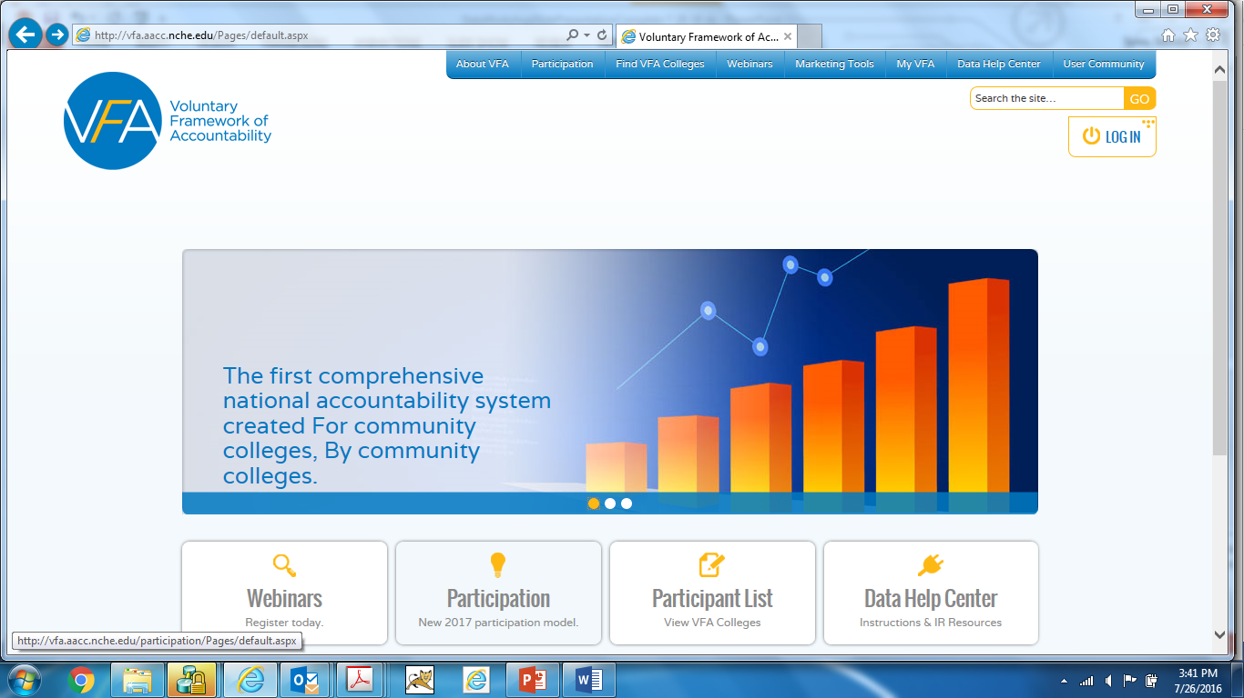
VFA - Resources
DS-10
http://vfa.aacc.nche.edu/Pages/default.aspx

Slide 46
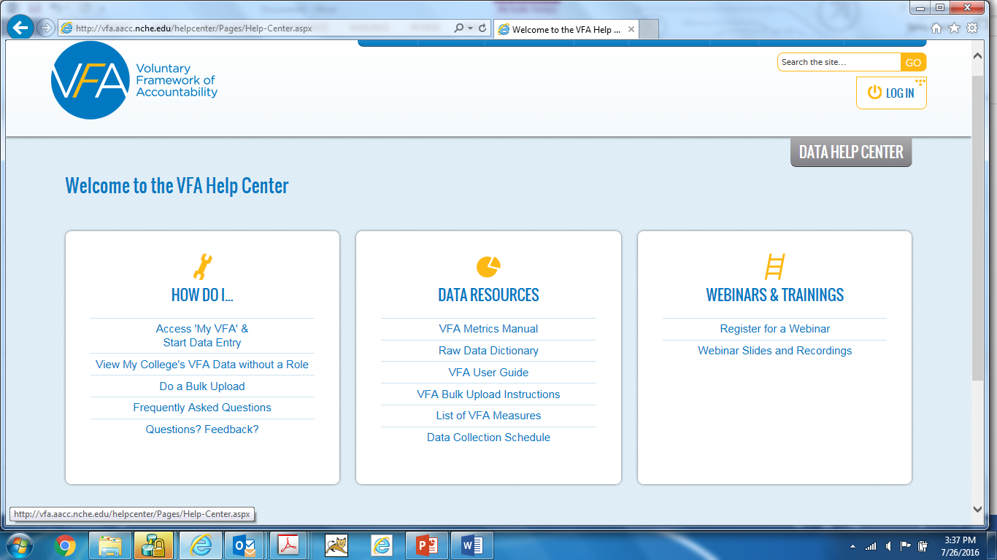
VFA - Resources
DS-11
http://vfa.aacc.nche.edu/helpcenter/Pages/Help-Center.aspx

Slide 47
Gainful Employment Summary
Erin Shirey
Business Intelligence Systems Analyst Institutional Research Mott Community College
ES-1

Slide 48
Gainful Employment - Purpose
10/28/2010:
Holding Programs Accountable for Preparing Students for Gainful Employment.
Protecting consumers from misleading or overly aggressive recruiting practices, and clarifying State oversight responsibilities.
Ensuring that only eligible students receive federal funds.
Clarifying the courses that are eligible for federal aid, and the amount of aid that is appropriate.
Reference:
http://www.ed.gov/news/press-releases/department-education-establishes-new-student-aid-rules-protect-borrowers-and-taxpayers
ES-2

Slide 49
Gainful Employment - History
2010-
October- Department of Education requires Title IV accepting schools to:
Report certain information on students enrolled in a Gainful Employment Program
Disclose certain information on Gainful Employment Programs to prospective students
Notify the U.S. Secretary of Education if adding additional GE Programs to its list of Title IV-eligible programs
2011-
July- Regulations released effective
November 15- Final reporting deadline
2012-
June- GE reporting regulations vacated by the U.S. District of Columbia
November- U.S Secretary of Education new program notification still required
- Institutions still required to publish Disclosures
2015-
July- 2008-09 through 2013-14 reporting deadline
October- 2014-15 reporting deadline
2016-
October- 2015-16 reporting deadline
ES-3

Slide 50
Gainful Employment - Current State
Completers list to institutions for verification: June 13, 2016
Completers list challenges/exclusions due: July 28, 2016
Reporting: October 1, 2016
Draft debt to earnings ratios to institutions: January, 2017
Disclosure deadline: January, 2017
ES-4

Slide 51
GE - NSLDS User Guide
http://ifap.ed.gov/nsldsmaterials/attachments/NSLDSGainfulEmploymentUserGuide.pdf
ES-5

Slide 52
Gainful Employment - Reporting
Who to report:
Students who received Title IV aid within the reporting year.
Students enrolled in an active certificate program within the reporting year.
What to report:
Award Year
Student Detail
Institution Detail
Program Detail
Student Program Detail
Student Financial Aid Detail
When to report:
10/1/16 (2015-16 students)
ES-6

Slide 53
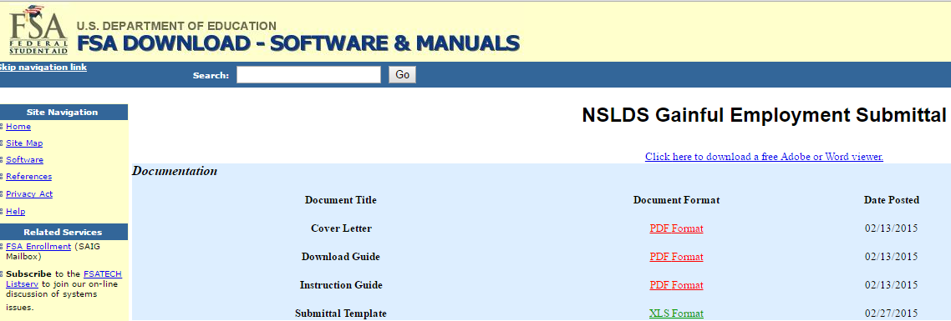
Gainful Employment - Reporting
Reporting Manuals/Tools: https://www.fsadownload.ed.gov/NSLDSGainEmp.htm
ES-7

Slide 54
Gainful Employment - Disclosure
What to report:
All currently active Pell eligible certificate programs (credit and non-credit clock hour/short term experimental)
Program Details
Cost
Completions
Completer Debt
Job placement rates (NOT required in MI)
When:
January of each year
Note: New Disclosures will be effective 1/1/17
Disclosures must be accessible on your public website and program promotional materials
ES-8

Slide 55
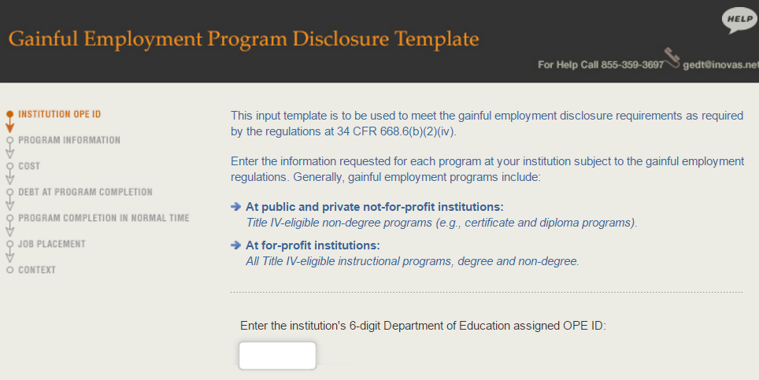
GE - Current Disclosure Template
Disclosure template: http://ope.ed.gov/GainfulEmployment/
ES-9

Slide 56
GE - Published Disclosure
ES-10

Slide 57
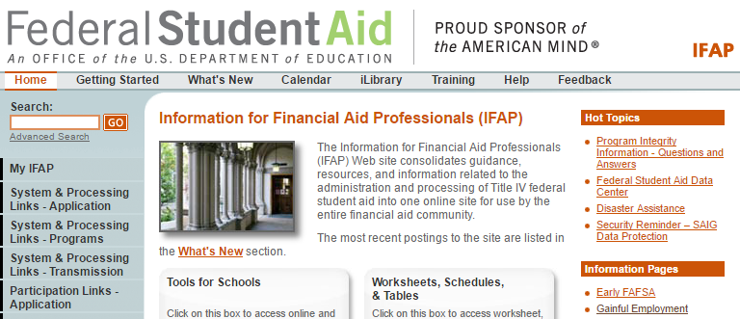
Gainful Employment - Resources
IFAP (Information for Financial Aid Professionals): http://www.ifap.ed.gov/ifap/
ES-11

Slide 58
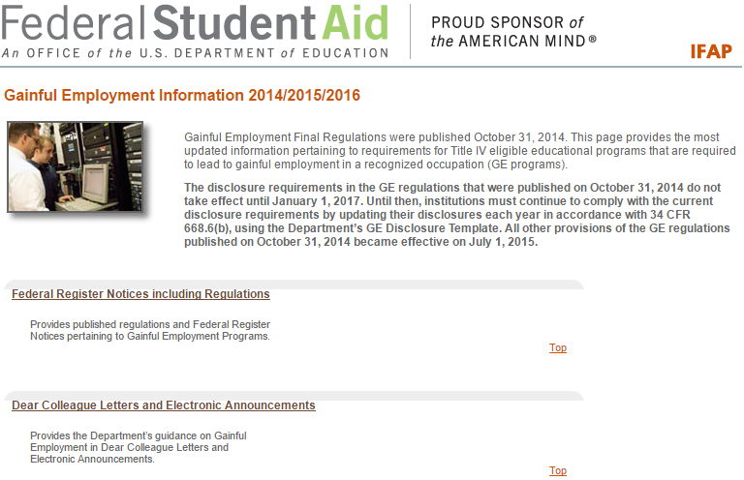
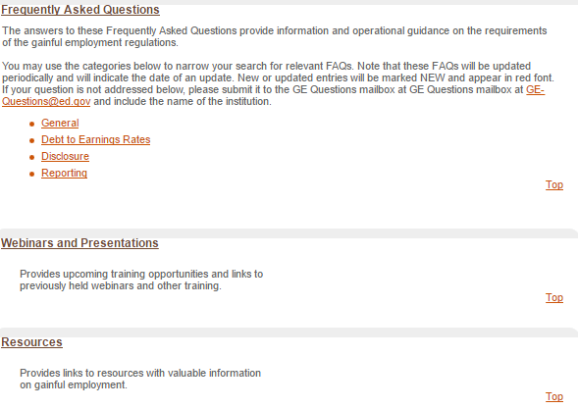
ES-12

Slide 59
Higher Learning Commission (HLC) North American Indian Tuition Waiver (NAITW) Dual Enrollment Section 209 Update
Nick Baker Director, Institutional Research Kirtland Community College
NB-1

Slide 60
Higher Learning Commission
Annual Data Update – due in early April
HLC requires each member institution to provide an update on organizational health through the Institutional Update.
Two parts: Financial Indicators and Non-Financial Indicators
Monitoring criteria were established with baseline year in 2014/2015.
NB-2

Slide 61
Higher Learning Commission
Financial Indicators
The financial data submitted in the Institutional Update generate a Composite Financial Index (CFI).
For public institutions, HLC relies on the financial ratios recommended in Strategic Financial Analysis for Higher Education: Identifying, Measuring & Reporting Financial Risks (Seventh Edition), by KPMG LLP; Prager, Sealy & Co., LLC; Attain LLC.
Non-Financial Indicators
Enrollment Changes
Degrees Awarded
Full-time Faculty Changes
Student Default Rates
Minimal Full-time Faculty
Student to Teacher Ratio
Weak Graduation and/or Persistence Rates Compared to Peers
NB-3

Slide 62
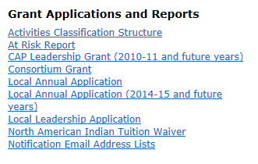
North American Indian Tuition Waiver
Due November 1st
Required by Public Act 201 of 2012.
Reporting period July 1st – June 30th of prior academic year.
Reported on the michigancc.net website
Three page report – first page is contact information of the individual reporting the information and last page is certification.
NB-4

Slide 63
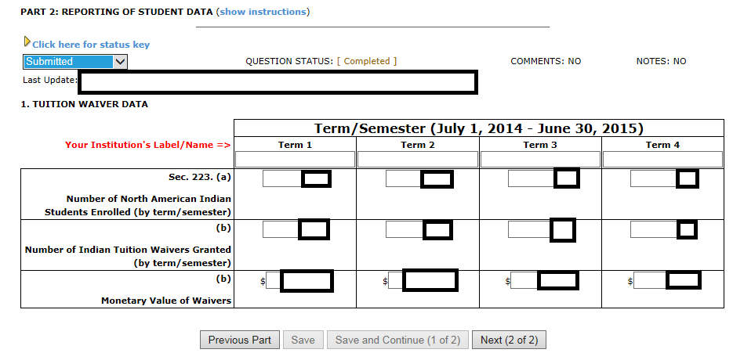
Second Page – Tuition Waiver Data
Must change status to Submitted from Work In Progress on each page and verify, on the final page, that you certify the information provided.
NB-5

Slide 64
Dual Enrollment Reporting – Section 209
Required by the State Aid Act of 1979 section 209 and 245.
Due November 15th annually
Submit report to Center for Educational Performance and Information (CEPI).
Post the report under the ‘Budget Transparency Icon’ of the college website.
Reporting is broken into four categories
State Approved Career and Technical Education/Tech Prep Articulation
Direct College Credit or Concurrent Enrollment
Dual Enrollment
Early College/Middle College Program
Reporting spreadsheet template provided by CEPI.
NB-6

Slide 65
NB-7

Slide 66
Miscellaneous Data Collections & Reporting
Achieving the Dream
NCES (National Center for Education Statistics) – random/occasional data collections – NPSAS (National Postsecondary Student Aid Survey), PEQIS (Postsecondary Education Quick Information System)
National Higher Education Benchmarking Institute – National Community College Benchmarking Project (NCCBP), Cost and Productivity Project (NCCCPP), Workforce Training Benchmark Project, Maximizing Resources for Student Success
Community College Survey of Student Engagement (CCSSE)
Noel-Levitz Student Survey
College Directories – College Board (SAT), ACT Institutional Data Questionnaire, Wintergreen Orchard House
Common Data Set
EB-end

